Slide 1
Performance Testing
-Cassandra

Slide 2
Setting Performance Goals
Number of Clients
Intended Usage Patterns
Expected Peak Hours
Throughput
Latency

Slide 3
EXAMPLE:
The cluster must support 30,000 read operations per second from the available_rooms_by_hotel_date table with a 95th percentile read latency of 3 ms.

Slide 4
Trade-offs
Enabling SSTable compression in order to conserve disk space, at the cost of additional CPU processing
Throttling network usage and threads, which can be used to keep network and CPU utilization under control, at the cost of reduced throughput and increased latency
Increasing or decreasing number of threads allocated to specific tasks such as reads, writes, or compaction in order to affect the priority relative to other tasks or to support additional clients
Increasing heap size in order to decrease query times

Slide 5
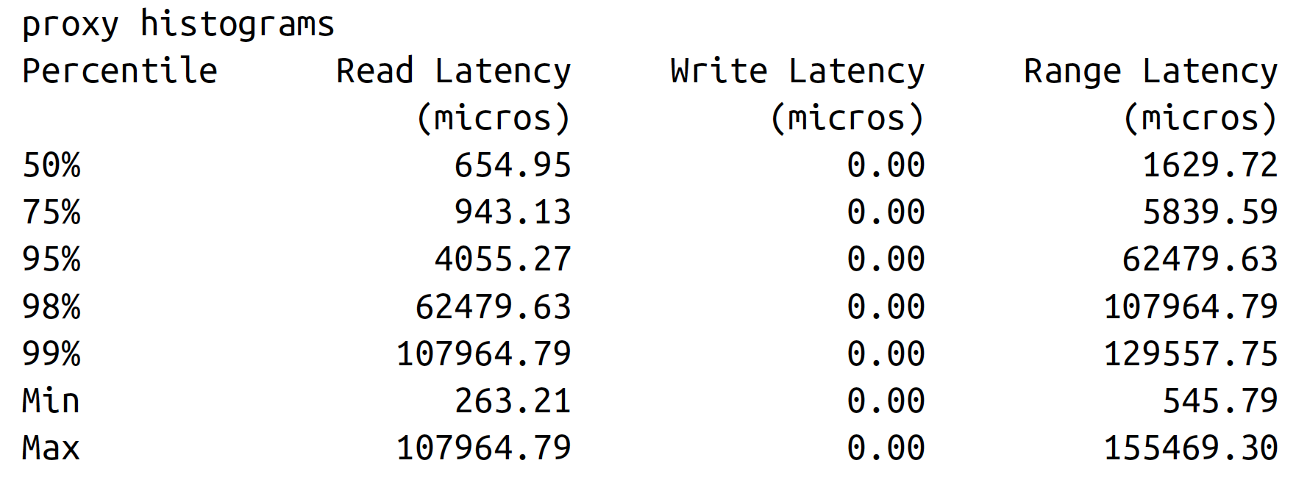
$ nodetool proxyhistograms

Slide 6
Tracing
TRACING ON

Slide 7
Caching
Key Cache
Row Cache

Slide 8
Compaction
Choosing the right compaction strategy for a table can certainly be a factor in improving performance

Slide 9
SizeTieredCompactionStrategy
The SizeTieredCompactionStrategy (STCS) is the default compaction strategy, and it should be used in most cases.
This strategy groups SSTables into tiers organized by size. When there are a sufficient number of SSTables in a tier (4 or more by default), a compaction is run to combine them into a larger SSTable. As the amount of data grows, more and more tiers are created.
STCS performs especially well for write-intensive tables, but less so for read-intensive tables, as the data for a particular row may be spread across an average of 10 or so SSTables

Slide 10
LeveledCompactionStrategy
The LeveledCompactionStrategy (LCS) creates SSTables of a fixed size (5 MB by default) and groups them into levels, with each level holding 10 times as many SSTables as the previous level.
LCS guarantees that a given row appears in at most one SSTable per level. LCS spends additional effort on I/O to minimize the number of SSTables a row appears in; the average number of SSTables for a given row is 1.11.
This strategy should be used if there is a high ratio of reads to writes or predictable latency is required.
LCS will tend to not perform as well if a cluster is already I/O bound. If writes dominate reads, Cassandra may struggle to keep up.

Slide 11
DateTieredCompactionStrategy
The DateTieredCompactionStrategy (DTCS) was introduced in the 2.0.11 and 2.1.1 releases.
It is intended to improve read performance for time series data, specifically for access patterns that involve accessing the most recently written data.
It works by grouping SSTables in windows organized by the write time of the data. Compaction is only performed within these windows. Because DTCS is relatively new and targeted at a very specific use case, make sure you research carefully before making use of it.

Slide 12
Concurrency and Threading
Cassandra differs from many data stores in that it offers much faster write performance than read performance. There are two settings related to how many threads can perform read and write operations: concurrent_reads and concurrent_writes.
In general, the defaults provided by Cassandra out of the box are very good.

Slide 13
concurrent_reads
The concurrent_reads setting determines how many simultaneous read requests the node can service. This defaults to 32, but should be set to the number of drives used for data storage A X 16.
This is because when your data sets are larger than available memory, the read operation is I/O bound.

Slide 14
concurrent_writes
The concurrent_writes setting behaves somewhat differently. This should correlate to the number of clients that will write concurrently to the server.
If Cassandra is backing a web application server, you can tune this setting from its default of 32 to match the number of threads the application server has available to connect to Cassandra.
It is common in Java application servers to prefer database connection pools no larger than 20 or 30, but if you’re using several application servers in a cluster, you’ll need to factor that in as well

Slide 15
Health Check
There are some basic things that you’ll want to look for to ensure that nodes in your cluster are healthy:
nodetool status
nodetool tpstats

Slide 16
Basic Maintenance
There are a few tasks that you’ll need to perform before or after more impactful tasks.
For example, it makes sense to take a snapshot only after you’ve performed a flush

Slide 17
Flush
To force Cassandra to write data from its memtables to SSTables on the filesystem, you use the flush command on nodetool, like this
nodetool flush

Slide 18
You can selectively flush specific keyspaces or even specific tables within a keyspace by naming them on the command line:
$ nodetool flush hotel
$ nodetool flush hotel reservations_by_hotel_date hotels_by_poi
Running flush also allows Cassandra to clear commitlog segments, as the data has been written to SSTables.

Slide 19
Cleanup
The cleanup command scans all of the data on a node and discards any data that is no longer owned by the node. You might ask why a node would have any data that it doesn’t own.
In both of these cases, Cassandra does not immediately delete the excess data, in case a node goes down while you’re in the middle of your maintenance. Instead, the normal compaction processes will eventually discard this data.
However, you may wish to reclaim the disk space used by this excess data more quickly to reduce the strain on your cluster. To do this, you can the nodetool cleanup command.

Slide 20
Repair
Cassandra provides multiple anti-entropy mechanisms to help mitigate against inconsistency. We’ve already discussed how read repair and higher consistency levels on reads can be used to increase consistency.
The final key element of Cassandra’s arsenal is the anti-entropy repair or manual repair, which we perform using the nodetool repair command

Slide 21
Handling Node Failure
From time to time, a Cassandra node may fail. Failure can occur for a variety of reasons, including: hardware failure, a crashed Cassandra process, or a virtual machine that has been stopped or destroyed.
A node that is experiencing network connectivity issues may be marked as failed in gossip and reported as down in nodetool status, although it may come back online if connectivity improves

Slide 22
Repairing Nodes
If the node has been down for less than the hints delivery window specified by the max_hint_window_in_ms property, the hinted handoff mechanism should be able to recover the node. Restart the node and see whether it is able to recover. You can watch the node’s logs or track its progress using nodetool status
If the node has been down for less than the repair window defined lowest value of gc_grace_seconds for any of its contained tables, then restart the node. If it comes up successfully, run a nodetool repair
If the node has been down for longer than the repair window, it should be replaced, in order to avoid tombstone resurrection

Slide 23
Backup and Recovery
Cassandra is built to be highly resilient to failure, with its support for configurable replication and multiple data centers. However, there are still a number of good reasons for backing up data

Slide 24
Reasons
Defects in application logic could cause good data to be overwritten and replicated to all nodes before the situation becomes known
SSTables can become corrupted
A multi–data center failure could wipe out your disaster recovery plan

Slide 25
Cassandra provides two mechanisms for backing up data: snapshots and incremental backups. Snapshots provide a full backup, while incremental backups provide a way to back up changes a little at a time

Slide 26
Taking a Snapshot
The purpose of a snapshot is to make a copy of some or all of the keyspaces and tables in a node and save it to what is essentially a separate database file. This means that you can back up the keyspaces elsewhere or leave them where they are in case you need to restore them later.
When you take a snapshot, Cassandra first performs a flush, and then makes a hard link for each SSTable file

Slide 27
Taking a snapshot is straightforward:
$ nodetool snapshot

Slide 28
Enabling Incremental Backup
After you perform a snapshot, you can enable Cassandra’s incremental backup usingthe nodetool enablebackup command. This command applies to all keyspaces and tables in the node.
You can also check whether incremental backups are enabled with nodetool status backup and disable incremental backups with nodetool disablebackup.
When incremental backups are enabled, Cassandra creates backups as part of the process of flushing SSTables to disk. The backup consists of a hard link to each data file Cassandra writes under a backups directory—for example:
$CASSANDRA_HOME/data/data/hotel/hotels-b9282710a78a11e5a0a5fb1a2fbefd47/
backups/
To enable backups across a restart of the node, set the incremental_backups property to true in the cassandra.yaml file.
You can safely clear incremental backups after you perform a snapshot and save the snapshot to permanent storage

